Slide 1


Project-arCc assuming responsibility for Climate change
Georgios A. Dafoulas,
Computer Science Department, Faculty of Science and Technology

Slide 2
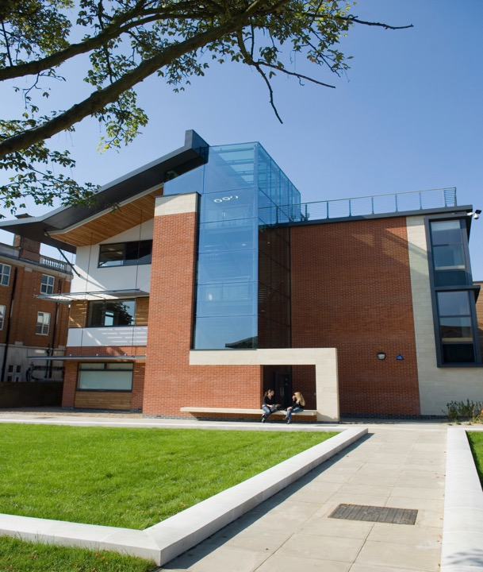
Project inception
Project vision
Partner presentation
Key themes
Project activities
Project timeline
Budget

Slide 3


Well done everyone!!!
480+ proposals were submitted
17 projects were accepted
Project-arc starts today!

Slide 4


Inception of Project-arCc
Creative Spark projects between Middlesex, Khazar and Kyrgyzstan National University
Reflected on the impact of the COVID-19 pandemic on project activities
Compared the diverse approach towards remote work, e-learning and virtual teams
Assessed the wider impact of the pandemic on education, training and collaboration
Identified an emerging opportunity to increase awareness about…
the positive impact of digital technologies on climate change
Open call for Creative Commissions, in response to climate change and COP26
Reflect on the impact of lifestyle on climate change
Realise the importance of individual accountability
Identify ways to demonstrate awareness of own responsibility to take action
Project-arCc
arc stands for assuming responsibility for Climate change

Slide 5
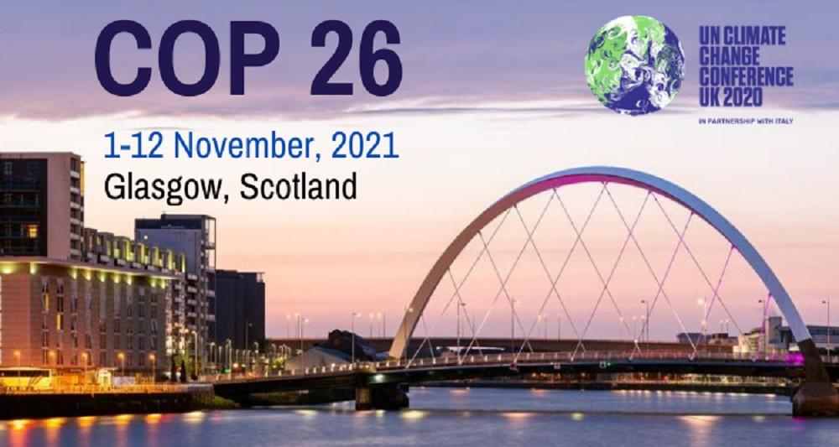

The vision of Project-arCc
Project – arCc will…
Enable the creation of a resource hub
Deploy local initiatives for Climate Change accountability and responsibility
Contribute to the COP26 with the project outcomes

Slide 6
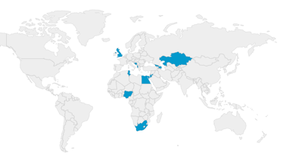
Project-arCc partnership
A truly international project supported by the British Council
Institution |  | Country
Middlesex University |  | UK
Oracle TES |  | UK
European University of Tirana |  | Albania
Khazar University |  | Azerbaijan
Dzemal Bijedic University of Mostar |  | Bosnia and Herzegovina
Arab Academy for Science and Technology |  | Egypt
Tbilisi State University |  | Georgia
Mutah University |  | Jordan
Innovative University of Eurasia |  | Kazakhstan
Universum College |  | Kosovo
University of Jos |  | Nigeria
Palestine Technical University-Kadoorie |  | Palestine
Nelson Mandela University |  | South Africa
Sousse University |  | Tunisia

Slide 7
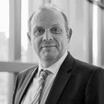
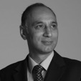
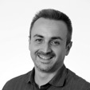
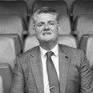


The UK partners
Project sponsors
Project management
Activity coordination
Prof Sean Wellington Deputy VC and Provost
Prof Balbir Barn Dean of SAT Faculty
Prof George Dafoulas Director of Programmes
Andy Golding Oracle TES MD
Ariadni Tsiakara Associate Lecturer
Cristiano Maia Associate Lecturer

Slide 8
Middlesex University invited staff
Helen Bendon H.Bendon@mdx.ac.uk Senior Lecturer in Film Production
Celia Bell C.Bell@mdx.ac.uk Deputy Dean
Sophia Drakopoulou S.Drakopoulou@mdx.ac.uk SL in Media Communications and Culture
James Graham J.Graham@mdx.ac.uk Senior Lecturer
Paul Harper P.N.Harper@mdx.ac.uk PR Officer
Kene Igweonu K.Igweonu@mdx.ac.uk Faculty Deputy Dean (Research and Knowledge Exchange)
Loraine Leeson L.Leeson@mdx.ac.uk Senior Lecturer in Fine Art
Vesna Lukic V.Lukic@mdx.ac.uk Lecturer in Film Production (Documentary)
Lian Lundy L.Lundy@mdx.ac.uk Professor of Environmental Science
Angela Martyn A.Martyn@mdx.ac.uk Director of Communications and External Engagement
Edward McCaffrey E.McCaffrey@mdx.ac.uk SL in Television Production
Simon McCarthy S.McCarthy@mdx.ac.uk Senior Research Fellow
Joshua Neicho J.D.Neicho@mdx.ac.uk PR Officer
Tanya O'Garra T.Ogarra@mdx.ac.uk Senior Lecturer in Economics
Alan Page A.Page@mdx.ac.uk Head of Department of Natural Sciences
Sally Priest S.Priest@mdx.ac.uk Associate Professor and Head, Flood Hazard Research Centre
Anne Ropiquet A.Ropiquet@mdx.ac.uk Senior Lecturer in Biology
Stephen Syrett S.Syrett@mdx.ac.uk Deputy Dean: Research & Knowledge Exchange
Franca Tranza F.Tranza@mdx.ac.uk PR Manager
Michael Westthorp M.Westhorp@mdx.ac.uk Senior Lecturer in Interiors
Gareth Williams G.R.Williams@mdx.ac.uk Head of Department of Design & Professor of Design
Bharain Mac an Bhreithiun B.MacAnBhreithiun@mdx.ac.uk Acting Head of Department, Visual Arts

Slide 9
Project-arCc themes
We will focus on the following themes:
Integrating e-learning in traditional education models.
Introducing flexible work arrangements using remote working models.
Rethinking travel and commuting needs.
Assessing possibilities for more efficient use of energy.
Evaluating consumption habits and waste reduction.
--- national initiatives will liaise with industry partners to consider ---
E-training models
Remote work arrangements
Travel reduction initiatives
Energy use revision plans
Resource consumption reflection

Slide 10
Project-arCc activities
Each partner will be required to support the following activities:
Micro-learning content on a range of Climate Change topics (the UK partners will create micro-learning online content to be used for educational purposes)
Webinars of Climate Change accountability and responsibility (the UK partners will provide a series of webinars will aim at training individuals on lifestyle change)
Accountability and Responsibility Competition (ARC) (at national level young people will be engaged through competitions aiming to trigger their reflection)
Virtual events for raising awareness (at national level partners will organise events aiming at raising public awareness)
Contribution on the arCc portal repository (each partner will provide contributions from local participants in the form of creative reflections e.g. artworks and individual premises)
--- national initiatives will seek the endorsement from key industry partners ---

Slide 11
Activity 1
Micro-learning content on a range of Climate Change topics
Middlesex University and Oracle will produce the necessary content that will fully describe the project’s five thematic areas
Content will be based on the SCATE pedagogic model and will be deployed on the SCATE platform
Each partner should aim for 200 students downloading/accessing the content and receive the certification for successfully completing the awareness quizzes

Slide 12
Activity 2
Webinars of Climate Change accountability and responsibility
Five webinars will be provided by Middlesex University, supported by Oracle TES in collaboration with each partner
The aim is for the participating institutions to provide brief add-ons to each webinar with emphasis on national contextualisation
Each partner to achieve at least 100 downloads/views of the webinars
The webinars will be also available to the public and disseminated widely at national level

Slide 13
Activity 3
Accountability and Responsibility Competition (ARC)
Each partner institution will organise a competition for its students, individuals from the local community and businesses that will provide reflection premises on their accountability and responsibility for climate change
All entries will be certified by Middlesex University and awards will be given to the best student, member of the public and business
All entries and awards will be certified by Middlesex University and the partner institution for each country
It is expected to have at least 50 student and individual entries in each partner, as well as 10 business entries

Slide 14
Activity 4
Virtual events for raising awareness
Towards the end of the project each partner institution will host a virtual event focusing on dissemination of the project’s outcomes
The event will share entries from the national competition and will include guest presenters with emphasis on increasing awareness of COP26
Each partner will aim to reach 50 participants for each event

Slide 15
Activity 5
Contribution on the arCc portal repository
Throughout the project, all partners will provide their contributions to the project portal
These contributions will include articles, posters, and recordings associated with climate change
The portal will also have a ‘My Premise’ section to share across the network individual reflections on accountability and responsibility

Slide 16
Project timeline
Activity | Apr | May | Jun | Jul | Aug | Sep | Oct
1. Micro-learning content | x | x
2. Webinars |  | x | x | x | x | x
3. Competition |  |  | x | x | x | x
4. Virtual events |  |  |  |  |  | x | x
5. Repository | x | x | x | x | x | x | x

Slide 17
Project budget
Budget Item | Cost per unit | Number of units | Total cost | Notes
Webinar contribution | 100 | 5 | £500 | 5 webinars @ £100 per webinar
Competition - organisation | 500 | 1 | £500 | Coordination, contribution and management
Virtual event - organisation | 500 | 1 | £500 | Coordination, contribution and management
Project management | 50 | 10 | £500 | 10 partial days per month @ £50 per day
Total ---> |  |  | £2,000

Slide 18
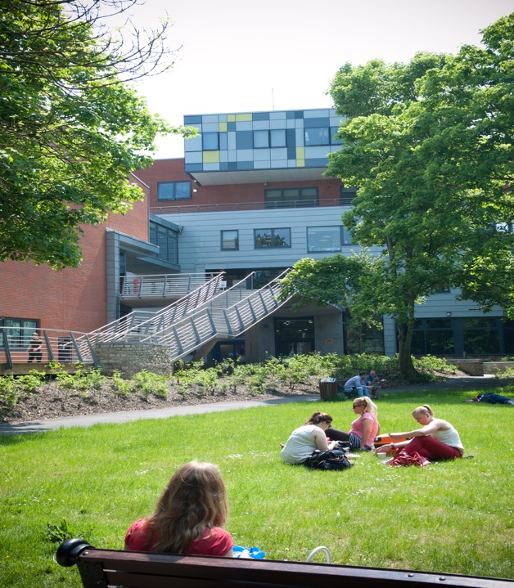
Sign partnership agreements
Send bank details for first installment
Email the details of your team
Confirm team leader
Provide name, rle or job title, email addres
Start planning
Webinars
Competition
Virtual event
Repository – attract contributions
Key Performance Indicators
Course completions
Webinars attendees and YouTube views
Competition entries
Virtual event attendees
Repository entries

Slide 19
THANK YOU!
Any questions?
Project-arCc
G.Dafoulas@mdx.ac.uk
C.CardosoMaia@mdx.ac.uk
A.Tsiakara@mdx.ac.uk
Notes:
We’re on admissions chat

